Slide 1
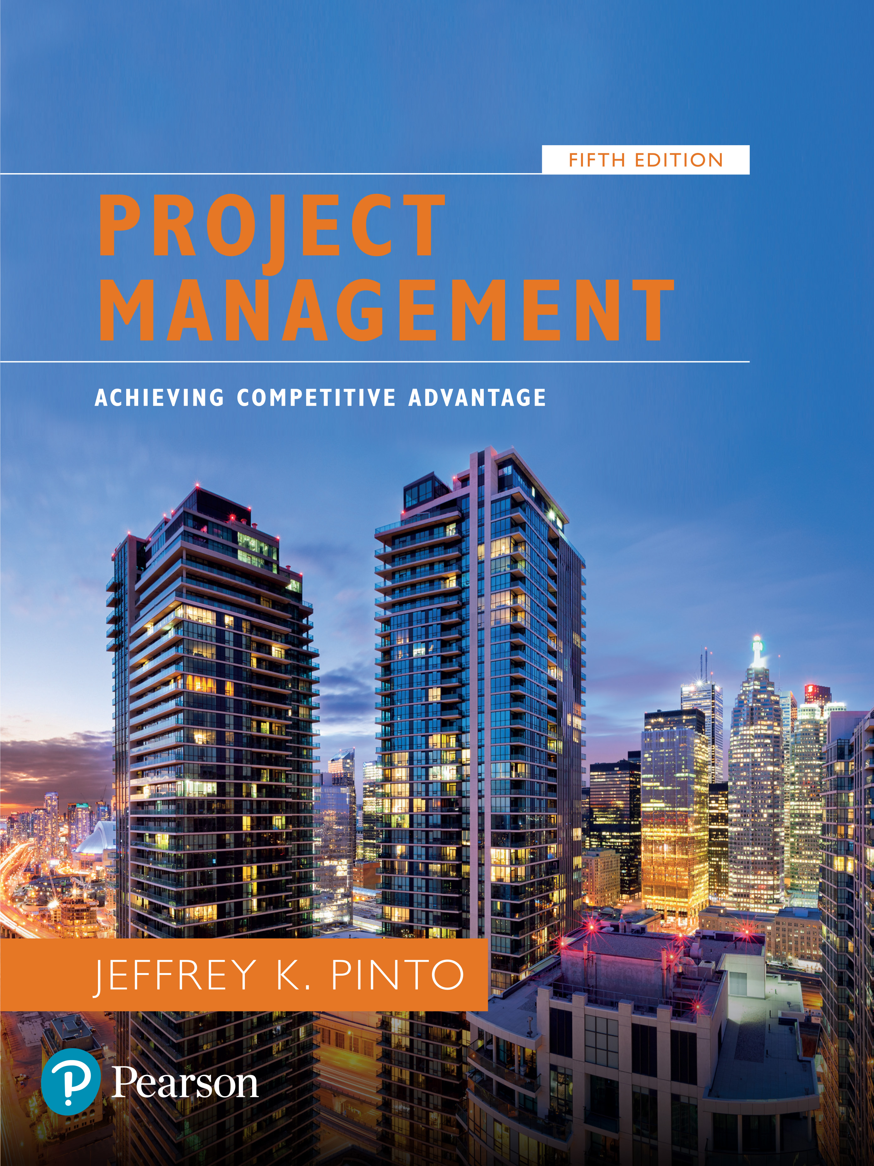
Project Management: Achieving Competitive Advantage
Fifth Edition
Chapter 8
Cost Estimation and Budgeting
Copyright © 2019, 2016, 2013 Pearson Education, Inc. All Rights Reserved
Notes:
If this PowerPoint presentation contains mathematical equations, you may need to check that your computer has the following installed:
1) MathType Plugin
2) Math Player (free versions available)
3) NVDA Reader (free versions available)

Slide 2
Learning Objectives
8.1 Understand the various types of common project costs and key differences between them.
8.2 Apply common forms of cost estimation for project work, including ballpark estimates, definitive estimates, parametric estimates, and learning curve.
8.3 Apply top-down, bottom-up, activity-based, and time-phased budgeting procedures for cost management.
8.4 Recognize the appropriateness of applying contingency funds for cost estimation.

Slide 3
P M B o K Core Concepts
Project Management Body of Knowledge (P M B o K) covered in this chapter includes:
Plan Cost Management (P M B o K 7.1)
Estimate Costs (P M B o K 7.2)
Determine Budget (P M B o K 7.3)
Control Costs (P M B o K 7.4)

Slide 4
Cost Management
Cost management has been defined to encompass data collection, cost accounting, and cost control.
Cost accounting and cost control serve as the chief mechanisms for identifying and maintaining control over project costs.
Cost estimation processes create a reasonable budget baseline for the project.

Slide 5
Common Sources of Project Cost
Labor
Materials
Subcontractors
Equipment and facilities
Travel

Slide 6
Types of Costs
Direct Versus Indirect
Recurring Versus Nonrecurring
Fixed Versus Variable
Normal Versus Expedited

Slide 7
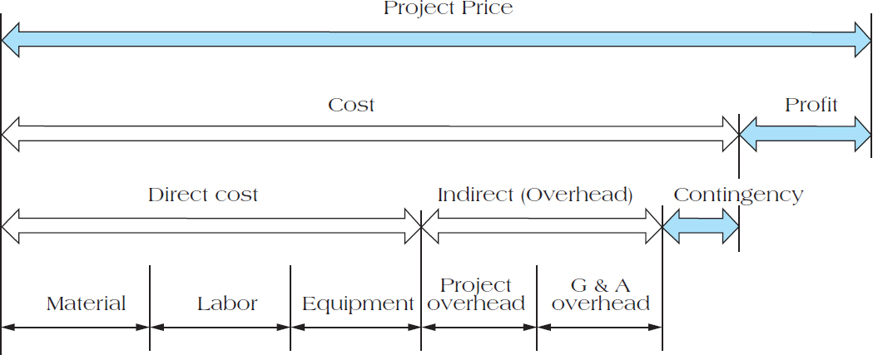
Figure 8.2 Project Price Breakdown

Slide 8
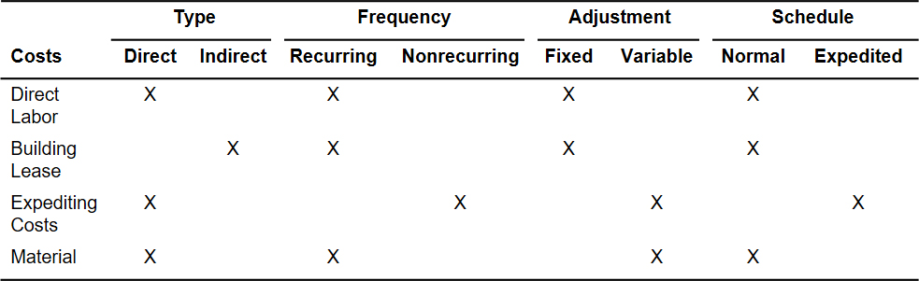
Table 8.2 Cost Classifications

Slide 9
Cost Estimation
Ballpark (order of magnitude)
Comparative
Feasibility
Definitive

Slide 10
Learning Curves
Each doubling of output results in a reduction in time to perform the last iteration.
Where :
Y_{x} = the time required for the x unit of output
a = the time required for the initial unit of output
X = the number of units to be produced
b = learning curve slope

Slide 11
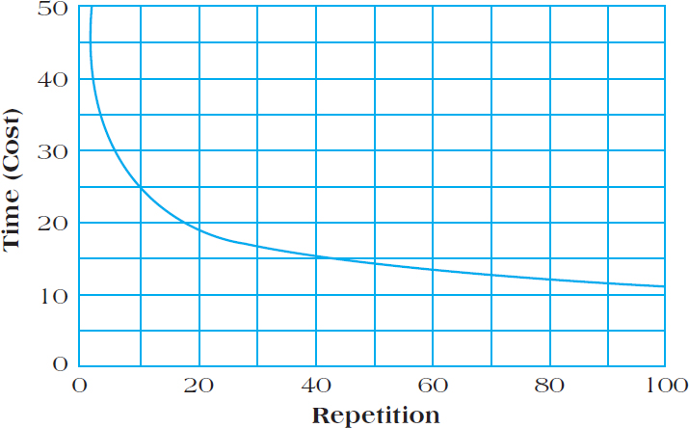
Figure 8.6 Unit Learning Curve Log-Linear Model

Slide 12
Software Project Estimation—Function Points
Function Point Analysis is a system for estimating the size of software projects based on what the software does.
Function Points are a standard unit of measure that represents the functional size of a software application.

Slide 13
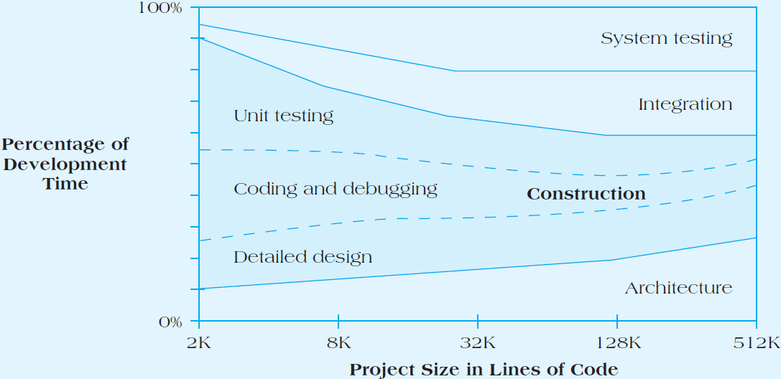
Figure 8.7 Software Project Development Activities as a Function of Size

Slide 14
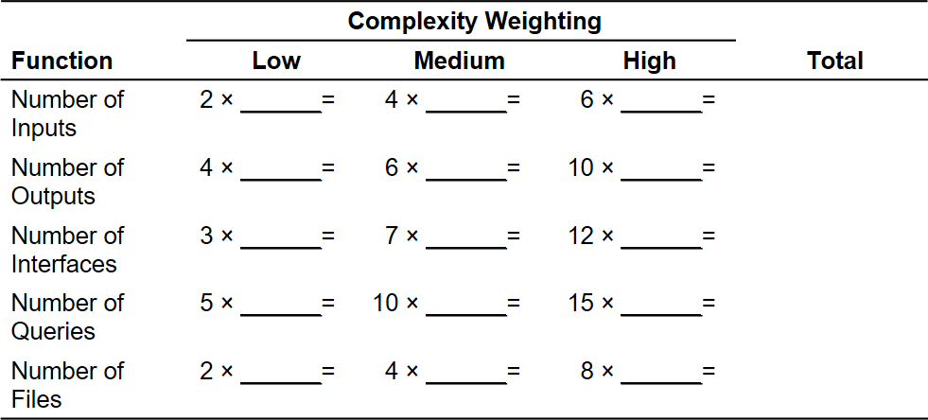
Table 8.4 Complexity Weighting Table for Function Point Analysis

Slide 15
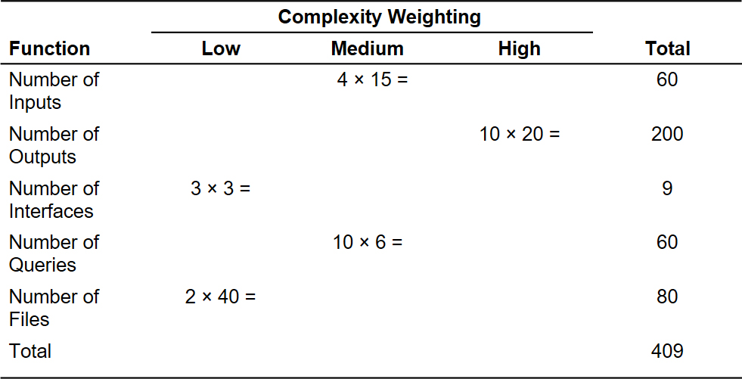
Table 8.5 Function Point Calculations for Restaurant Reorder System

Slide 16
Problems with Cost Estimation
Low initial estimates
Unexpected technical difficulties
Lack of definition
Specification changes
External factors

Slide 17
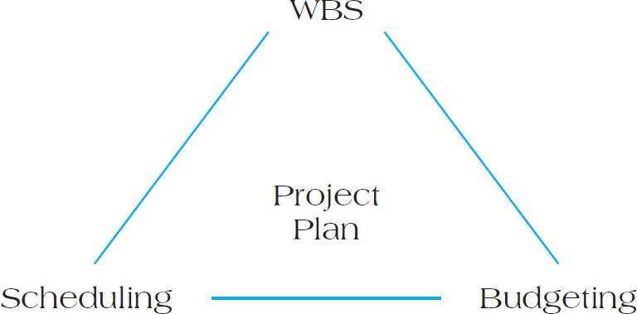
Creating a Project Budget
The budget is a plan that identifies the resources, goals, and schedule that allows a firm to achieve those goals.
Figure 8.8 The Relationship Among W B S, Scheduling, and Budgeting
Top-down
Bottom-up
Activity-based costing (A B C)

Slide 18
Activity-Based Costing
Projects use activities and activities use resources.
Assign costs to activities that use resources.
Identify cost drivers associated with this activity.
Compute a cost rate per cost driver unit or transaction.
Multiply the cost driver rate times the volume of cost
driver units used by the project.

Slide 19
Table 8.6 Sample Project Budget
Activity | Direct Costs | Budget Overhead | Total Cost
Survey | 3,500 | 500 | 4,000
Design | 7,000 | 1,000 | 8,000
Clear Site | 3,500 | 500 | 4,000
Foundation | 6,750 | 750 | 7,500
Framing | 8,000 | 2,000 | 10,000
Plumb and Wire | 3,750 | 1,250 | 5,000

Slide 20
Table 8.7 Sample Budget Tracking Planned and Actual Activity Costs
Activity | Direct Costs | Budget Overhead | Total Cost
Survey | 4,000 | 4,250 | 250
Design | 8,000 | 8,000 | - 0 -
Clear Site | 4,000 | 3,500 | (500)
Foundation | 7,500 | 8,500 | 1,000
Framing | 10,000 | 11,250 | 1,250
Plumb and Wire | 5,000 | 5,150 | 150
Total | 38,500 | 40,650 | 2,150

Slide 21
Table 8.8 Example of a Time-Phased Budget
Activity | January | February | Months March | April | May | Total by Activity
Survey | 4,000 | Blank | Blank | Blank | Blank | 4,000
Design | Blank | 5,000 | 3,000 | Blank | Blank | 8,000
Clear Site | Blank | 4,000 | Blank | Blank | Blank | 4,000
Foundation | Blank | Blank | 7,500 | Blank | Blank | 7,500
Framing | Blank | Blank | Blank | 8,000 | 2,000 | 10,000
Plumb and Wire | Blank | Blank | Blank | 1,000 | 4,000 | 5,000
Monthly Planned | 4,000 | 9,000 | 10,500 | 9,000 | 6,000 | Blank
Cumulative | 4,000 | 13,000 | 23,500 | 32,500 | 38,500 | 38,500

Slide 22
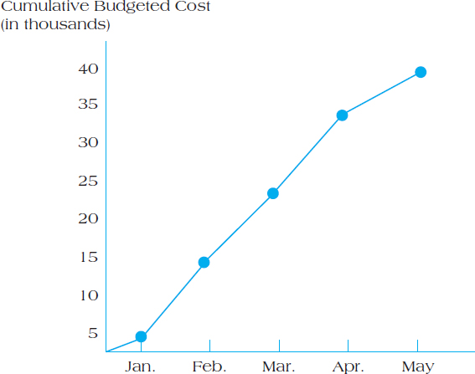
Figure 8.9 Cumulative Budgeted Cost of the Project

Slide 23
Budget Contingencies
The allocation of extra funds to cover uncertainties and improve the chance of finishing on time.
Contingencies are needed because:
Project scope may change
Murphy’s Law is present
Cost estimation must anticipate interaction costs
Normal conditions are rarely encountered

Slide 24
Benefits to Contingency Funding
Recognizes future contains unknowns
Adds provision for company plans for an increase in project cost
Applies contingency fund as an early warning signal to a potential overdrawn budget

Slide 25
Summary
Understand the various types of common project costs and key differences between them.
Apply common forms of cost estimation for project work, including ballpark estimates, definitive estimates, parametric estimates, and learning curve.
Apply top-down, bottom-up, activity-based, and time-phased budgeting procedures for cost management.
Recognize the appropriateness of applying contingency funds for cost estimation.

Slide 26

Copyright

